Slide 1



QLIK SENSE
Presented by: OUIRRA SALAH EDDINE
EL OTMANI CHADI OTMAN
Aoutouf abdrahim
Supervised by: Pr. Nawal SAEL

Slide 2




Plan
Overview
Advantages
Qlik sense versions
workshop
2

Slide 3


  QlikSense is Qlik’s next-generation application forself-service oriented visual analytics, offering unique and powerful data visualization, exploration, and collaboration capabilities forall types ofusers
3

Slide 4
Overview
4

Slide 5


Three fundamental forces impact the use of BI and Analytics
Anexplosion of data andcontent
Anexplosion in computing power
Arise ofthe information activist
5
Notes:
as for any project before diving in into the practical phase you search about you will need and how can you approach it .

Slide 6
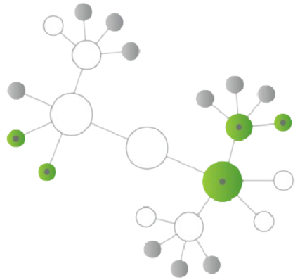
Qlik’s Associative Model
Qlik’s associative model empowers everyone to see the whole story that lives within their data.
It enables users to probe all the possible associations that exist in their data, across all of their data sources. This means users are not limited by predefined hierarchies or preconceived notions of how data should be related, but can finally understand how it is truly related.
6

Slide 7
Advantages
7

Slide 8
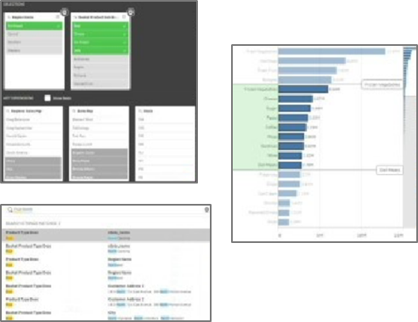
Associative Model
Intuitively navigate complex information, ask questions, and understand relationships in data
8

Slide 9
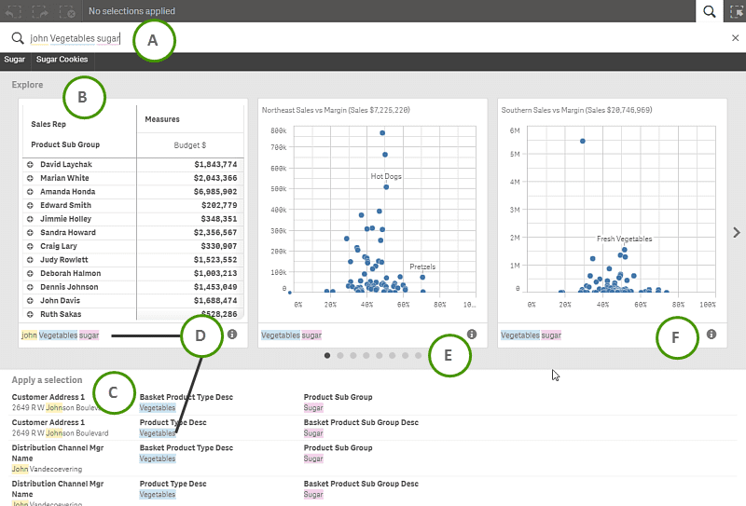
Smart Search
•Globalsearch across theentire app andall your data using keywords:
–Multiple keyword search fordata andassociations
–Visual search forcharts andobjects
–Search within filters andfields
•Dimension matches andrelationships rankedbased onstrength of associations
•Chartsand graphs returned asvisual thumbnails
9

Slide 10
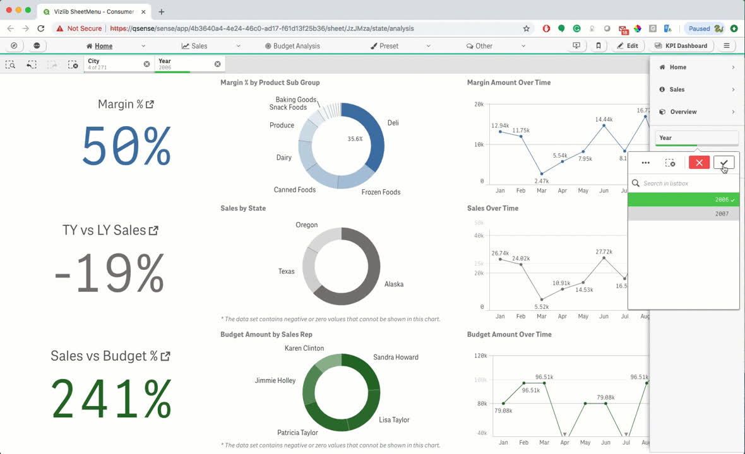
Modern User Experience
•An elegant and intuitive user interface
–Streamlinedgraphics anddesigns
–Simplifiedlayout andnavigation
–Orientation techniques
•Streamlined ability to navigate, performanalysis,and gain insight
•Uses cutting edge HTML5 technology availablethrough allmodern browsers ordesktop appon PC
10

Slide 11
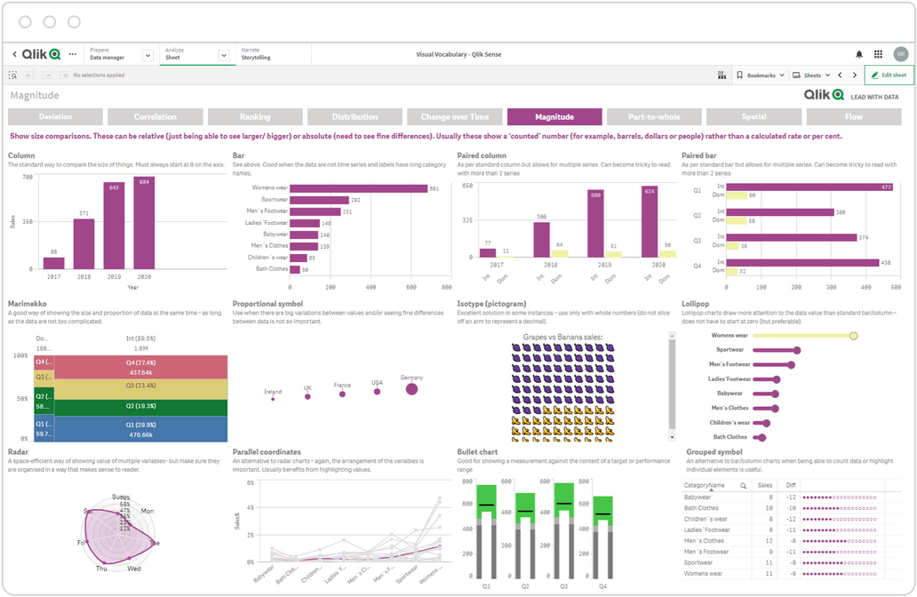
Visual Exploration
•Allows users tochange the properties of visualizations andobjects while exploring
•Includes alternate dimensions and measures, sort order, color schemes, andchart presentations
•Users can‘cycle’ between alternate dimensions andmeasures using visual exploration
•New views areretained specific tothe user, andusers canrevert back todefault views
11

Slide 12
Versions
12

Slide 13

Versions
Individuals
Groups
Organizations
Self-Service Visualization and Exploration
Sharing of Knowledge and Insights
APlatform for the Entire Enterprise
13

Slide 14
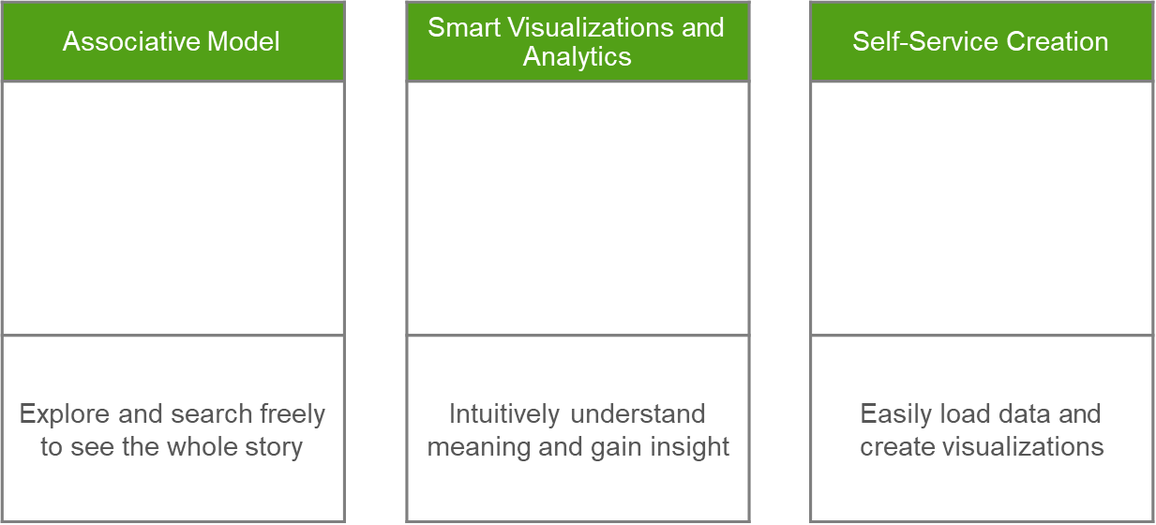

For individuals of all skill
levels
14
Notes:
Random Forest got 87% and 96% accuracy on these articles but the draw back Ijssem limited the dataset to personality traits and Pandey had only 800 entries in the dataset which is not enough for this type of project .
same thing for Huber regressor in Majjate's article where the result makes hopes high for a valid model but the dataset had only 500 entries .

Slide 15
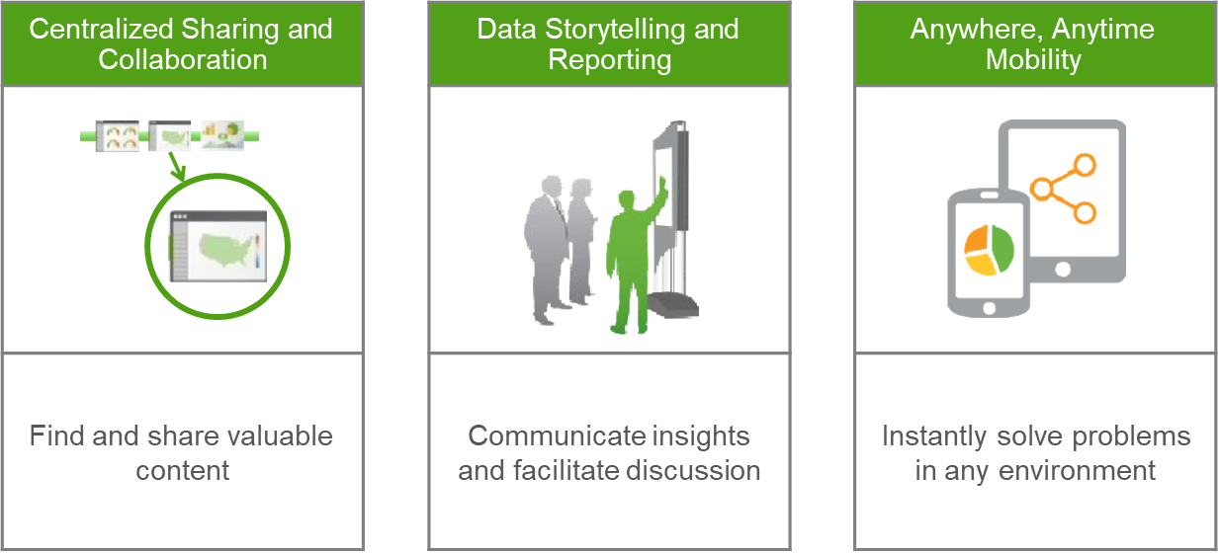
Sharing of Knowledge and Insights
For groups and teams
15
Notes:
Random Forest got 87% and 96% accuracy on these articles but the draw back Ijssem limited the dataset to personality traits and Pandey had only 800 entries in the dataset which is not enough for this type of project .
same thing for Huber regressor in Majjate's article where the result makes hopes high for a valid model but the dataset had only 500 entries .

Slide 16
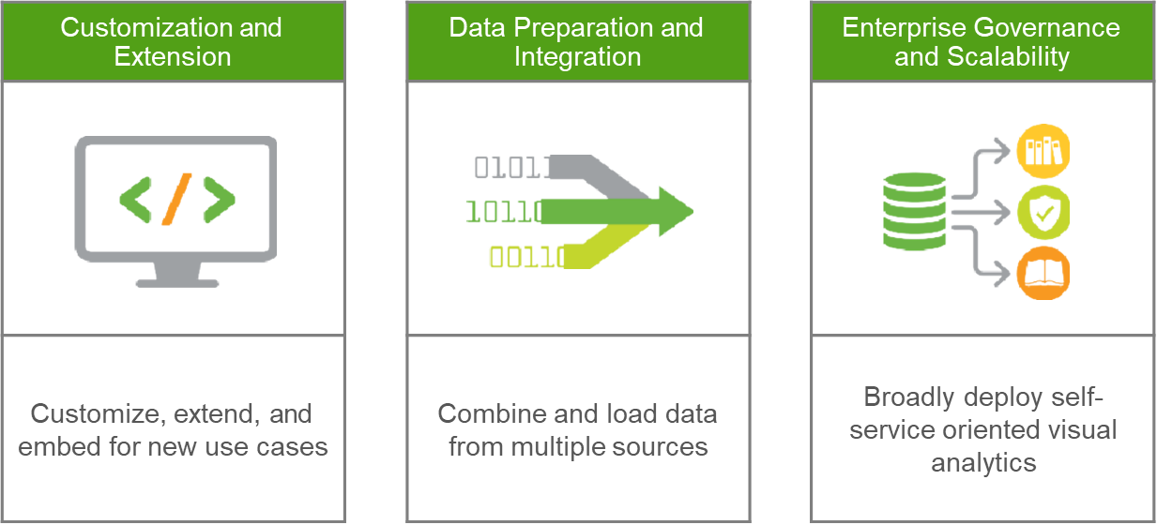
A Platform for the Entire Enterprise
For your organization
16
Notes:
Random Forest got 87% and 96% accuracy on these articles but the draw back Ijssem limited the dataset to personality traits and Pandey had only 800 entries in the dataset which is not enough for this type of project .
same thing for Huber regressor in Majjate's article where the result makes hopes high for a valid model but the dataset had only 500 entries .

Slide 17
Workshop
17

Slide 18
Thank you
18

